Slide 1

QUARTERLY BUSINESS REPORT Q4’ 2018
Dency Thomas, AIML Online July 23A

Slide 2

BUSINESS KEY METRICS POST Q4’2018: The 21.5% of good feedback suggests that there is a portion of satisfied customers. However, it's also important to analyze the feedback categorized as "not good" to identify areas for improvement.
Total Revenue
Total Orders
48.61m$
1000
Total Customers
% Good feedback
994
21.5
Last Quarter Revenue
Last Quarter Orders
8.57m$
199
Average Rating
Average days to Ship
3.135
97.964

Slide 3
CUSTOMER METRICS

Slide 4

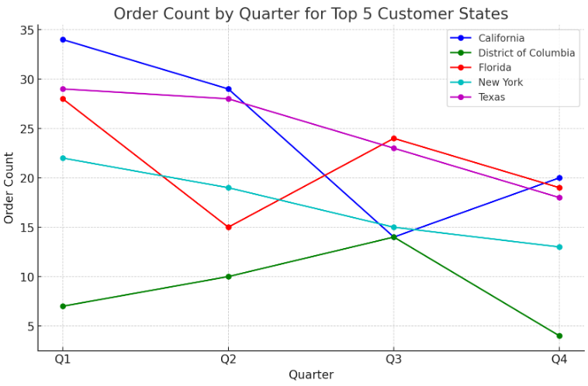


Distribution of Customers across States: Texas and California are our biggest markets. These states not only have the highest number of customers but also lead in terms of the total number of orders, indicating a strong market presence in these regions. Across these States, peak in demand is observed in Quarter 1 with District of Columbia being an exception where Q1 performed poorer than Q2 and Q3. The lowest demand is being observed in Quarter 4 with California and Florida being an exception where Q3 and Q2 saw poorer demand respectively. Leverage the peaks observed in certain quarters by launching seasonal marketing campaigns.
Top 5 States by Customer Count
Texas:
Customer Count: 97
Total Orders: 98
Total Order Value: $8,057,453.14
California:
Customer Count: 97
Total Orders: 97
Total Order Value: $8,113,870.73
Florida:
Customer Count: 86
Total Orders: 86
Total Order Value: $7,159,422.76
New York:
Customer Count: 69
Total Orders: 69
Total Order Value: $5,780,442.55
District of Columbia:
Customer Count: 35
Total Orders: 35
Total Order Value: $2,957,118.21

Slide 5
Customer Rating: The average customer rating by quarter decreased from Quarter 1 to Quarter 4
Average Customer Rating by Quarter
Customer Rating is highest in Quarter 1 which is a direct result of peak season in most States particularly Texas, California, Florida and New York which comprise the Company’s strongest customer base by count.
Use Q4, the quarter with the lowest rating, to launch a festive campaign or year-end sale to improve the perception
Introduce special promotions or loyalty rewards for customers who shop in quarters with lower satisfaction ratings. This might help to boost satisfaction by providing extra value.

Slide 6
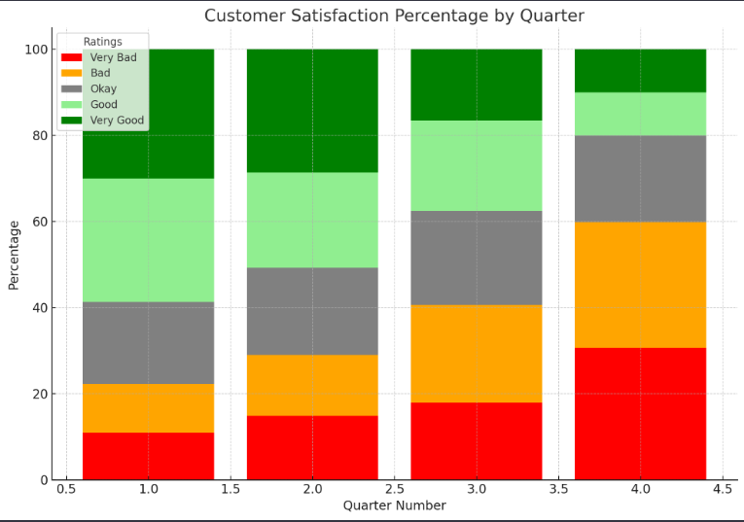
Customer Satisfaction: Quarter 4 needs to be analysed in depth for peak in ‘Very Bad’ and ‘Bad’ Ratings
Trend of Customer Satisfaction
The 100% stacked bar chart displays the distribution of customer feedback ratings—Very Bad, Bad, Okay, Good, and Very Good—for each quarter. Here's an analysis of the trends:
Quarter 1 shows the most balanced distribution of feedback, with the highest combined percentage of 'Good' and 'Very Good' ratings, suggesting a strong start to the year. This could be a period of high customer satisfaction, possibly due to fresh marketing initiatives or new year promotions.
Quarter 2 sees a slight increase in negative feedback ('Very Bad' and 'Bad') and a decrease in positive feedback ('Good' and 'Very Good'). This may be indicative of a seasonal trend or a dip in customer satisfaction as initial enthusiasm wanes.
Quarter 3 shows a more pronounced increase in negative feedback and a significant drop in 'Very Good' ratings. The reasons for this trend should be investigated—possible factors could include product issues, service quality, or external market influences.
4.Quarter 4 exhibits the most concerning trend, with 'Very Bad' and 'Bad' ratings peaking and 'Good' and 'Very Good' ratings being the lowest across all quarters. The reasons for this trend should be investigated—possible factors could include product issues, service quality, or external market influences.

Slide 7
Popular Vehicle Makers by Customer: Chevrolet is the most popular brand among customers, followed by Ford, Toyota, Dodge, and Pontiac.
Top Vehicle Makers preferred by Customers
It's essential to understand why these brands are popular among customers. Is it due to their price point? To find out please observe the charts. Below are a few observations from the charts:
Chevrolet appears to have the third highest average price and also the highest total sales among the vehicle makers shown, indicating a strong market performance in Q1' 2018. Chevrolet has diverse product offering for its customers compared to other brands.
Dodge and Ford show similar very high average prices, but Ford's total sales surpass those of Dodge, suggesting better market penetration or customer preference for Ford in this period.
Pontiac and Toyota have lower average prices compared to the American brands, which could be an indication of different market positioning, possibly targeting a more price-sensitive segment.
The Total Sales line indicates that Chevrolet leads by a significant margin, while the others have relatively similar sales figures.

Slide 8
Popular Vehicle Makers by State: Local economy and brand loyalty shapes customer choice of preferred Vehicle Maker
Most Preferred Vehicle Maker in each State
State | Customer Count | Vehicle Maker | Rank Number
Alabama | 5 | Dodge | 1
Arizona | 3 | Cadillac | 1
 | 3 | Pontiac | 1
California | 6 | Audi | 1
 | 6 | Chevrolet | 1
 | 6 | Dodge | 1
 | 6 | Ford | 1
 | 6 | Nissan | 1
Colorado | 5 | Chevrolet | 1
District of Columbia | 4 | Chevrolet | 1
Florida | 7 | Toyota | 1
Georgia | 3 | Toyota | 1
Illinois | 3 | Chevrolet | 1
 | 3 | Ford | 1
 | 3 | GMC | 1
Indiana | 4 | Mazda | 1
Maryland | 5 | Ford | 1
Michigan | 3 | Ford | 1
Minnesota | 3 | GMC | 1
Missouri | 4 | Chevrolet | 1
Nevada | 3 | Pontiac | 1
New York | 5 | Pontiac | 1
 | 5 | Toyota | 1
North Carolina | 3 | Volvo | 1
Ohio | 6 | Chevrolet | 1
Pennsylvania | 3 | Toyota | 1
Tennessee | 3 | Mazda | 1
Texas | 9 | Chevrolet | 1
Virginia | 5 | Ford | 1
Washington | 5 | Chevrolet | 1
Table on the left shows top Vehicle Makers by State and Customer Count. For the sake of brevity we have excluded Vehicle Makers which had only one or two Customers in a State yet was Ranked 1 for being the only Vehicle Maker having one or two customer(s) in that State.
Here’s a summary based on the visible data:
Multiple Top Rankers: Several states have multiple vehicle makers tied with a rank number of 1. This suggests that these vehicle makers have the same highest customer count in those states.
State Preferences: Different states have different top vehicle makers. For instance, Chevrolet is the top vehicle maker in California, Colorado, and Ohio, while Ford is the top in Maryland, Michigan, and Virginia.
Market Diversity: The diversity of top vehicle makers across States indicates varied consumer preferences, possibly influenced by regional factors such as the local economy and brand loyalty.
This data can be utilized to tailor marketing strategies and inventory distribution to match the preferences in each state. For instance, in states where Chevrolet is the most popular, marketing campaigns could focus on that brand's vehicles, whereas in states where Ford is the top, the emphasis could be on Ford models. This approach ensures that marketing efforts and product availability are aligned with the established customer base and preferences in each region.

Slide 9
REVENUE METRICS

Slide 10
Customer Purchase Trends: Seasonal fluctuation in demand observed with peak demand in Quarter 1 and fall in demand Quarter on Quarter thereafter
Trend of Purchases by Quarter
Here are a few observations based on the chart:
Revenue and Orders Trend: There appears to be a downward trend in both total revenue and total orders from the first quarter to the fourth quarter. The line indicating total orders shows a significant drop after the first quarter, while the decline in total revenue is more gradual.
Seasonal Variations: The data might suggest seasonal variations in sales and revenue. Typically, Q1 can include new model releases or end-of-year sales carried over from Q4 of the previous year, which can account for higher numbers. The subsequent quarters show a decrease which could be due to various factors like market saturation, economic factors, or consumer behavior.
Discounts alone are not helping boost Sales: The third quarter shows a significant rise in discounts to 69.83%. This peak could coincide with end-of-season sales, summer promotions, or other marketing efforts to accelerate purchases during a traditionally slower sales period. The effect of discount on Sales is minimal during this period.

Slide 11
Revenue Trends: Best Percentage Change in Revenue observed in Quarter 4 driven by lower revenues in both Quarter 3 and Quarter 4
Quarter on Quarter % change in Revenue
Here are the observed trends:
Quarter 2: There is a drop in revenue by 27.23% compared to the previous quarter.
Quarter 3: The downward trend continues with a further decline of 32.31%.
Quarter 4: There is a sharp reversal, and revenue decreases by a smaller percentage 3.48%.
This chart suggests that the business experiences significant seasonal fluctuations, with revenues declining in the middle quarters and then looks like its beginning to recover in Q4. However, observing the graph on the right we can say the best Percentage Change in Revenue observed in Quarter 4 driven by lower revenues and total orders in both Quarter 3 and Quarter 4

Slide 12
SHIPPING METRICS

Slide 13
Discount offered on Credit Card: Best Discount Offered on Laser Credit Cards at 64.38% followed by Mastercard offering 62.95% to its Credit Card users
Average Discount offered by Credit Card type
Above Average Discounts: 'visa-electron', 'china-unionpay', 'mastercard', 'maestro', 'instapayment', and 'diners-club-carte-blanche' offer discounts above 62%, which are quite generous compared to others.
Mid-Range Discounts: 'jcb', 'switch', 'americanexpress', 'visa', 'bankcard', and 'diners-club-us-ca' have discounts ranging from approximately 60% to 62%.
Lowest Discounts: 'diners-club-international' and 'solo' offer the lowest average discounts at 58.40% and 58.50% respectively.
Variation in Discounts: The variation in discounts can be due to the agreements between credit card companies and the merchant, the rewards structure of the card, or promotional campaigns.
Here are the observations:
Highest Discounts: The credit card type 'laser' offers the highest average discount of 64.38%, which might indicate a special promotion or a loyalty program associated with this card type.

Slide 14
Shipping Time: Delayed Shipping Time could be driving customer unsatisfaction and churn out
Time taken to Ship Orders by Quarter
Here are the observations:
Shipping Time and Sales Correlation: As the year progresses, there is a notable increase in shipping times. This trend correlates with a decrease in both order count and total revenue. It could be inferred that as shipping times increase, customer satisfaction might decrease, potentially affecting the number of orders and revenue.
Seasonal Factors: The increase in shipping times could be due to seasonal factors that affect logistics, such as adverse weather conditions in Q3 and Q4.

Slide 15
INSIGHTS

Slide 16
Insights & Recommendations: Managing Customer Satisfaction Customer Satisfaction is central to any business a careful analysis of negative feedback is the first step towards value driven growth
Logistical efficiency is the need of the hour
Management should focus on Operational Efficiency: The significant increase in shipping times from Q1 to Q4 suggests a need for improvement in operational efficiency. This could involve optimizing logistics, enhancing supply chain management, or expanding shipping and handling capacity, especially in anticipation of Q4 demands.
Customer Expectations has to be proactively managed: Extended shipping times, especially in Q4, may require the business to manage customer expectations better through communication and service. Offering expedited shipping options or compensatory discounts could be strategies to maintain customer satisfaction.
Strategic Planning for quicker shipping: Planning for increased resources or alternative shipping arrangements in Q3 and Q4 could help to address the elongated shipping times and mitigate their impact on sales and revenue. Distributed inventory management could be one stop solution to all supply chain woes. Distributed inventory is a goods distribution strategy in which inventory is stored in and shipped from multiple fulfillment centers or warehouses located in different geographic areas.
Here are the observations:
Delayed Shipping could be driving customers unhappy: As the year progresses, there is a notable increase in shipping times. This trend correlates with a decrease in both order count and total revenue. It could be inferred that as shipping times increase, customer satisfaction might decrease, potentially affecting the number of orders and revenue.
Seasonal Factors could be at play for delayed Shipping: The increase in shipping times could be due to seasonal factors that affect logistics, such as adverse weather conditions in Q3 and Q4.

Slide 17
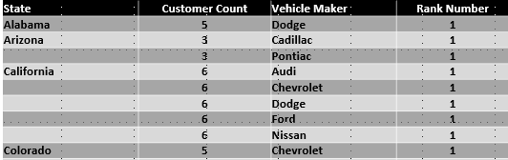
Insights & Recommendations: Hitting the bulls-eye with impactful marketing strategies Strong Marketing Team can make a sea change in customer perception Leverage the peaks observed in certain quarters by launching seasonal marketing campaigns.
Marketing builds Company Reputation
Customer Name | Email ID | Order Count
Cindy Gertray | cgertray6n@mapy.cz | 2
Standford Goodhall | sgoodhallfz@mozilla.com | 2
Armstrong Cripin | acripin4u@loc.gov | 2
Laurette Carn | lcarn7b@upenn.edu | 2
Barbee Cathel | bcathelk@paginegialle.it | 2
Gonzales Shoard | gshoard4v@example.com | 2
Vivien Roelvink | vroelvinkhj@netscape.com | 1
Top 5 States by Order Count | Most Preferred Vehicle Makers
California | Dodge
California | Ford
California | Nissan
California | Chevrolet
California | Audi
District of Columbia | Chevrolet
Florida | Toyota
New York | Pontiac
New York | Toyota
Texas | Chevrolet
Here are the observations:
Marketing and distributed inventory management should go hand in hand: Data such as Vehicle Maker popularity by State can be utilized to tailor marketing strategies and inventory distribution to match the preferences in each state. For instance, in states where Chevrolet is the most popular, marketing campaigns could focus on that brand's vehicles, whereas in states where Ford is the top, the emphasis could be on Ford models. This approach ensures that marketing efforts and product availability are aligned with the established customer base and preferences in each region. It should be the responsibility of the marketing team to inform the customers about the expertise of its operationally efficient inventory management system which will boost customer trust in the business.
There should be focus on collecting and publicizing detailed feedback from previous customers who had positive experience: There is no better marketing than word of mouth from past customers. Detailed feedback can be collected using emails for customer convenience. We should also think of incentivizing the customer for providing such feedback such as gifting them a token of appreciation for their support towards the business. Maintaining a healthy relationship by providing special offers for repeat purchases can also entice them to keep coming back.
Seasonal marketing campaigns for seasonal business cycle: Seasonal marketing campaigns can boost revenues during peak period in Quarter 1 when New Year releases are available for sale. Partnering with more Credit Card Companies during peak season could boost sales.

